Slide 1
Solar Shading optimization
Justin Roberts

Slide 2
Outline
Background
History
Developing the Model
Analysis
Future Work

Slide 3
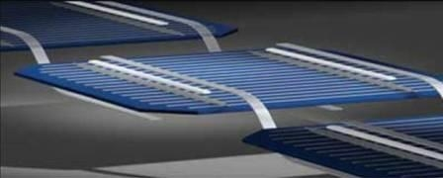
Background
Each solar cell produces .5 volts
Effects on power performance
Temperature
Partial Shading
Series/Parallel Connectivity

Slide 4
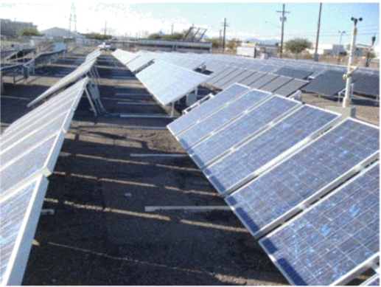
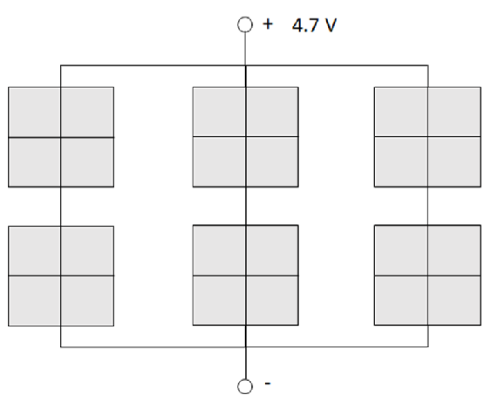
Partial Shading Effects
Thakkar, N. et al., 2010. A simple non-linear model for the effect of partial shade on PV systems. In Photovoltaic Specialists Conference (PVSC), 2010 35th IEEE. pp. 002321–002326.

Slide 5
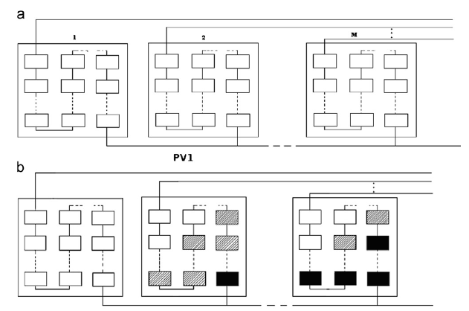
Partial shading effects
Chowdhury, S.R. & Saha, H., 2010. Maximum power point tracking of partially shaded solar photovoltaic arrays. Solar energy materials and solar cells, 94(9), pp.1441–1447.

Slide 6
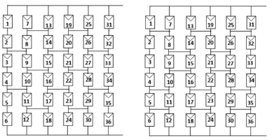
Serial parallel connectivity
Malathy, S. & Ramaprabha, R., 2015. Comprehensive analysis on the role of array size and configuration on energy yield of photovoltaic systems under shaded conditions. Renewable and Sustainable Energy Reviews, 49, pp.672–679.

Slide 7
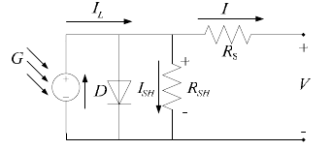
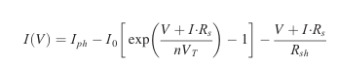
Modeling
Peled, A. & Appelbaum, J., 2017. Enhancing the power output of PV modules by considering the view factor to sky effect and rearranging the interconnections of solar cells. Progress in Photovoltaics: Research and Applications, 25(9), pp.810–818.
González-Longatt, F.M. & others, 2005. Model of photovoltaic module in Matlab. Ii Cibelec, 2005, pp.1–5.

Slide 8
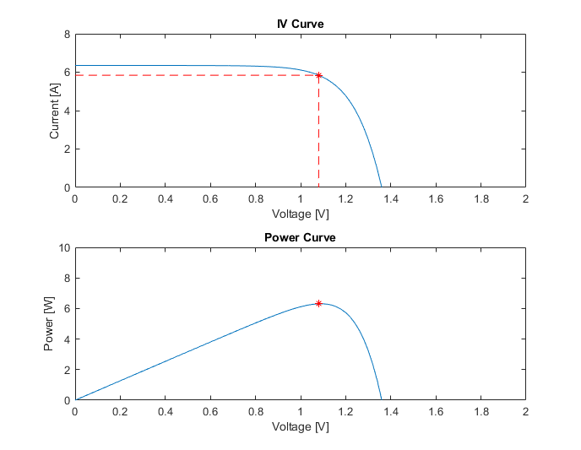
single cell

Slide 9
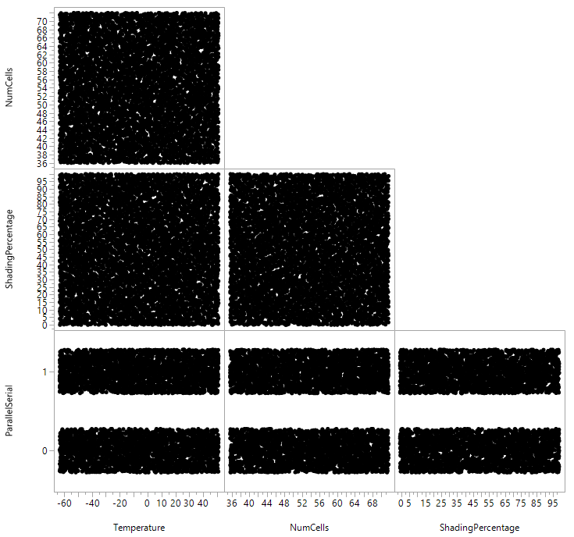
DOE – Uniform shading
FACTORS
Number of Cells
36-72
Shading Percentage
0-100%
Parallel or Serial
Temperature
- 62 – 52 ˚C
OUTPUT
Maximum Power

Slide 10
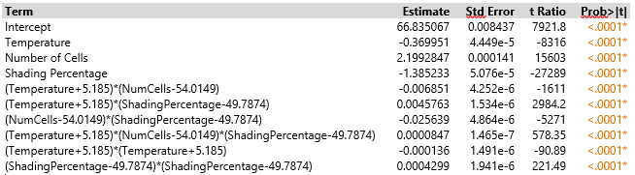
Parameter estimates
Notes:
Minimized BIC and AIC

Slide 11
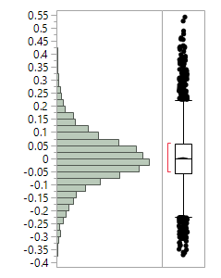
Goodness of fit
Normal Plot
Actual by Predicted Plot
Residual by Predicted Plot
R-Squared = .999995
R-Squared Adjusted = .999995

Slide 12
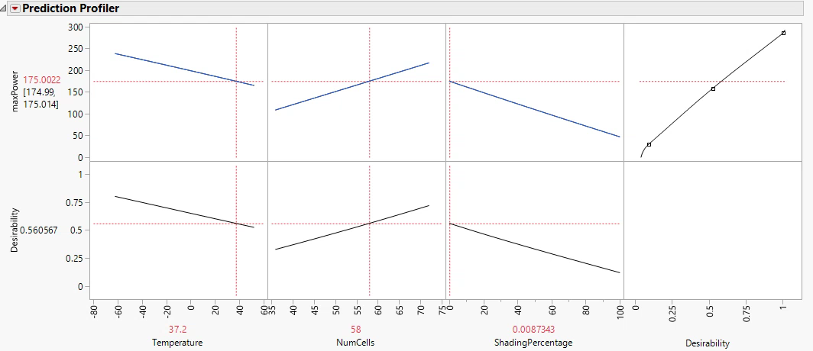
Optimization profiler

Slide 13
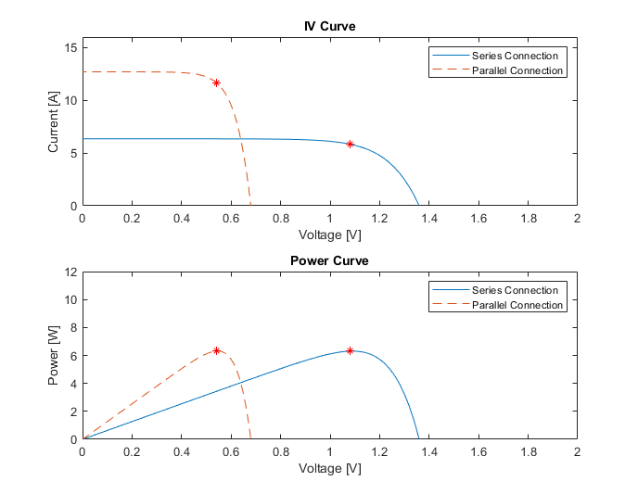
2 cells in series and parallel
Uniform Shading
Max Power = 6.3 (W)

Slide 14
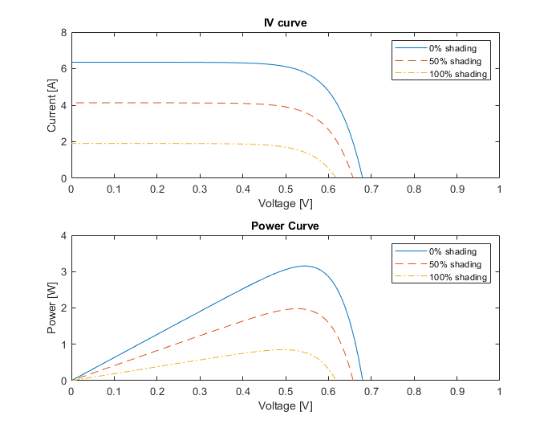
Partial shading of individual cells

Slide 15
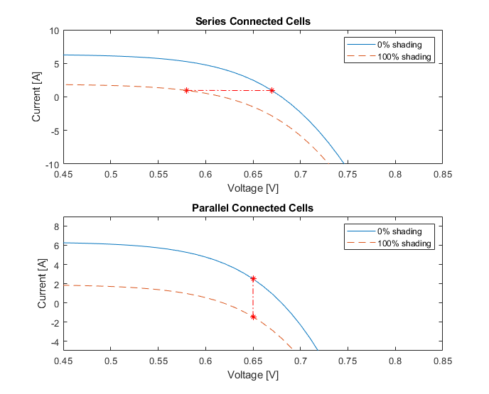
Partial shading connections

Slide 16
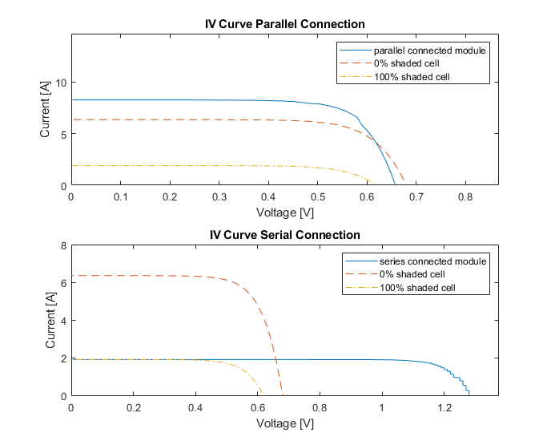
2 Cells in Series and Parallel
Series Max Power = 2 (W)
Parallel Max Power = 4 (W)

Slide 17
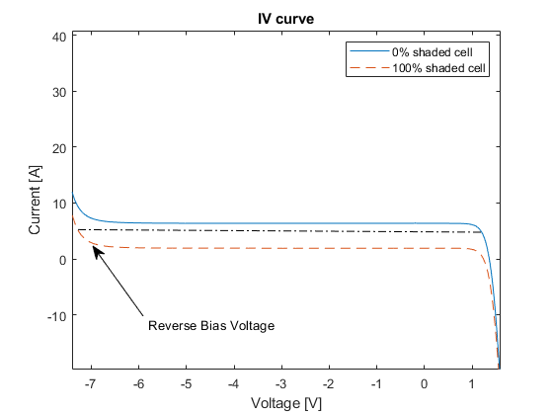
Series Reverse Bias

Slide 18
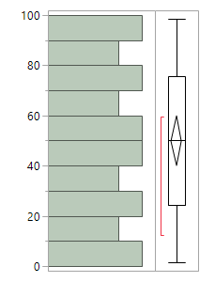
DOE shading inputs
Uniform Design
36 cells
60 cells
72 cells

Slide 19
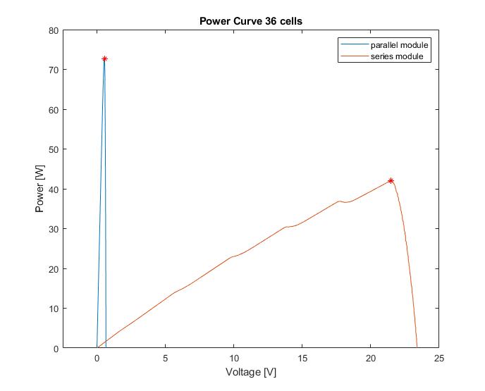
36 cell panel
Series Max Power = 42 (W)
Parallel Max Power = 73 (W)

Slide 20

60 cell panel
Series Max Power = 70 (W)
Parallel Max Power = 121 (W)

Slide 21
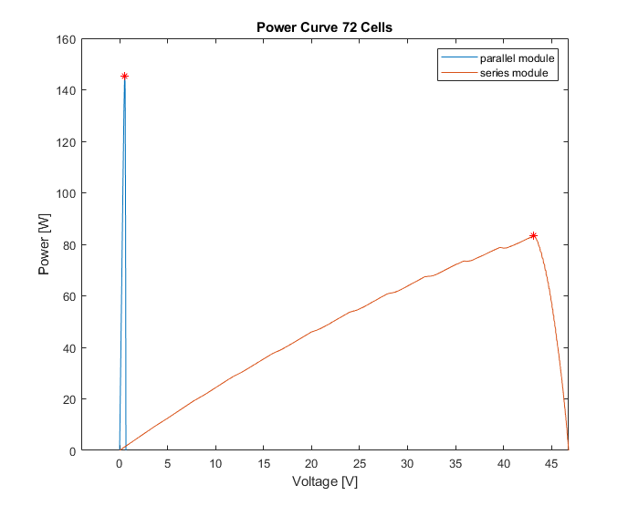
72 cell panel
Series Max Power = 83 (W)
Parallel Max Power = 145 (W)

Slide 22
Power Differences
Number of Cells in Module | Power Difference (W) (Parallel – Serial)
36 | 31
60 | 51
72 | 62

Slide 23
Conclusions
Parallel vs Serial connection doesn’t make a difference under uniform shading
Parallel connection performs better under non uniform shading
Shading a bigger contributor to solar performance than temperature

Slide 24
Future work/Publications
Journals
IEEE explore
Solar Energy Journal
A more automated model for non-uniform shading
Bypass diode configurations
More connection configurations than straight series and parallel

